Slide 1
D-STAR InfoCon 2014 at Dayton Hamvention
Part 2 – Using D-STAR
John Davis WB4QDX

Slide 2
Getting on the Air
FM Repeater
  Mode - FM
  Frequency
  Offset
  CTCSS / TSQ
  Tone frequency
D-STAR Repeater
  Mode - DV
  Frequency
  Offset
  UR
  RPT1
  RPT2

Slide 3
The Big Three
MY or MYCALL is your own callsign and is set once in radio
UR or URCALL: Where do I want to go?
RPT1: The repeater and module I am transmitting to (ex. KJ4GGV C)
RPT2: Where I want my transmission to go (normally to “G”, the Gateway)
    NOTE: It’s a good practice to put the callsign and “G” in RPT2 even if talking local so other linked repeaters, DV Dongles and DV Access Points can hear your transmissions

Slide 4
RPT1, RPT2 Format
Normal format (xxnxxx m)
    Callsign is left justified
    Module is always in 8th position
        C=VHF
        B=UHF
        A=1.2 GHz
Examples ("▪" represents a space )
    WD4STR▪C
    W4DOC▪▪C
    W4GR▪▪▪C

Slide 5
DPLUS adds functions
DPLUS is a program developed by Robin Cutshaw, AA4RC, which adds linking functions and the use of DV Dongles, DV Access Points and Hotspots to D-STAR. DPLUS is active on most gateway-equipped repeaters.
Characters used with DPLUS
  G – Gateway
  E - Echo Test
  I – Identification
  L – Link Repeater
  U – Unlink Repeater
5

Slide 6
Basic QSO
Sample for KJ4GGV VHF/2m Repeater
145.2800 MHz +5.0 MHz Offset
  MY WB4QDX
  UR CQCQCQ
  RPT1 KJ4GGV▪C
  RPT2 KJ4GGV▪G
"▪" represents a space
Used for talking on local repeater. If repeater is linked, you are also heard on any of the linked repeaters
6

Slide 7
Linking to a Repeater
Sample for KJ4GGV VHF/2m Repeater
145.2800 MHz +5.0 MHz Offset
  MY WB4QDX
  UR WX4GPBAL (or W4DOC▪CL, W4GR▪▪CL)
  RPT1 KJ4GGV▪C
  RPT2 KJ4GGV▪G
"▪" represents a space
Key once, gateway responds with voice prompt “Remote System Linked”. Change to CQCQCQ in UR for QSO.
7

Slide 8
Linking to a Reflector
Sample for KJ4GGV VHF/2m Repeater
145.2800 MHz +5.0 MHz Offset
  MY WB4QDX
  UR REF002AL
  RPT1 KJ4GGV▪C
  RPT2 KJ4GGV▪G
"▪" represents a space
Key once, gateway responds with voice prompt “Remote System Linked”. Change to CQCQCQ in UR for QSO.
8

Slide 9
Unlinking
Sample for KJ4GGV VHF/2m Repeater
145.2800 MHz +5.0 MHz Offset
  MY WB4QDX
  UR ▪▪▪▪▪▪▪U
  RPT1 KJ4GGV▪C
  RPT2 KJ4GGV▪G
"▪" represents a space
Key once, gateway responds with unlinked voice prompt. Change to CQCQCQ in UR for QSO.
9

Slide 10
Memory Management
Radios have different capabilities and number of memories
First generation radios have standard memory locations for FM or DV
      Method 1 – Store commands in memory for favorite reflectors or repeaters
      Method 2 – Use UR memories for favorite reflectors or repeaters (uses fewer memory locations
Newer radios with DR mode simplify programming
      Method 3 – Use DR mode with repeater list and GPS for nearest repeater

Slide 11
Radio Memory Management – Method 1
Organize blocks of channels stored in memories:
Can be used with any D-STAR radio
Create a group or bank of memories for each repeater
Store commands for each function in a memory of the group
CH No | Frequency | Dup | Offset | TS | Mode | Name | Your Call Sign | RPT1 Call Sign | RPT2 Call Sign
1 | 145.200 | DUP- | 0.6 | 10kHz | DV | KI4SBA C | CQCQCQ | KI4SBA C | KI4SBA G
2 | 145.200 | DUP- | 0.6 | 10kHz | DV | UNLINK | U | KI4SBA C | KI4SBA G
3 | 145.200 | DUP- | 0.6 | 10kHz | DV | SBA C ID | I | KI4SBA C | KI4SBA G
4 | 145.200 | DUP- | 0.6 | 10kHz | DV | REF001C | REF001CL | KI4SBA C | KI4SBA G
5 | 145.200 | DUP- | 0.6 | 10kHz | DV | REF002A | REF002AL | KI4SBA C | KI4SBA G
6 | 145.200 | DUP- | 0.6 | 10kHz | DV | REF004A | REF004AL | KI4SBA C | KI4SBA G
7 | 145.200 | DUP- | 0.6 | 10kHz | DV | REF030A | REF030AL | KI4SBA C | KI4SBA G
8 | 145.200 | DUP- | 0.6 | 10kHz | DV | REF030B | REF030BL | KI4SBA C | KI4SBA G
9 | 145.200 | DUP- | 0.6 | 10kHz | DV | REF030C | REF030CL | KI4SBA C | KI4SBA G
10 | 145.200 | DUP- | 0.6 | 10kHz | DV | ECHOTEST | E | KI4SBA C | KI4SBA G

Slide 12
Radio Memory Management - Talk
Use this channel for general QSO
No linking commands required or repeater already linked
CQCQCQ in UR field
CH No | Frequency | Dup | Offset | TS | Mode | Name | Your Call Sign | RPT1 Call Sign | RPT2 Call Sign
1 | 145.200 | DUP- | 0.6 | 10kHz | DV | KI4SBA C | CQCQCQ | KI4SBA C | KI4SBA G
2 | 145.200 | DUP- | 0.6 | 10kHz | DV | UNLINK | U | KI4SBA C | KI4SBA G
3 | 145.200 | DUP- | 0.6 | 10kHz | DV | SBA C ID | I | KI4SBA C | KI4SBA G
4 | 145.200 | DUP- | 0.6 | 10kHz | DV | REF001C | REF001CL | KI4SBA C | KI4SBA G
5 | 145.200 | DUP- | 0.6 | 10kHz | DV | REF002A | REF002AL | KI4SBA C | KI4SBA G
6 | 145.200 | DUP- | 0.6 | 10kHz | DV | REF004A | REF004AL | KI4SBA C | KI4SBA G
7 | 145.200 | DUP- | 0.6 | 10kHz | DV | REF030A | REF030AL | KI4SBA C | KI4SBA G
8 | 145.200 | DUP- | 0.6 | 10kHz | DV | REF030B | REF030BL | KI4SBA C | KI4SBA G
9 | 145.200 | DUP- | 0.6 | 10kHz | DV | REF030C | REF030CL | KI4SBA C | KI4SBA G
10 | 145.200 | DUP- | 0.6 | 10kHz | DV | ECHOTEST | E | KI4SBA C | KI4SBA G

Slide 13
Radio Memory Management - ID
Use to see if repeater is linked or unlinked
If linked, repeater says “Remote system linked”
Data line will indicate where repeater or reflector linked
Return to CQCQCQ channel to talk
CH No | Frequency | Dup | Offset | TS | Mode | Name | Your Call Sign | RPT1 Call Sign | RPT2 Call Sign
1 | 145.200 | DUP- | 0.6 | 10kHz | DV | KI4SBA C | CQCQCQ | KI4SBA C | KI4SBA G
2 | 145.200 | DUP- | 0.6 | 10kHz | DV | UNLINK | U | KI4SBA C | KI4SBA G
3 | 145.200 | DUP- | 0.6 | 10kHz | DV | SBA C ID | I | KI4SBA C | KI4SBA G
4 | 145.200 | DUP- | 0.6 | 10kHz | DV | REF001C | REF001CL | KI4SBA C | KI4SBA G
5 | 145.200 | DUP- | 0.6 | 10kHz | DV | REF002A | REF002AL | KI4SBA C | KI4SBA G
6 | 145.200 | DUP- | 0.6 | 10kHz | DV | REF004A | REF004AL | KI4SBA C | KI4SBA G
7 | 145.200 | DUP- | 0.6 | 10kHz | DV | REF030A | REF030AL | KI4SBA C | KI4SBA G
8 | 145.200 | DUP- | 0.6 | 10kHz | DV | REF030B | REF030BL | KI4SBA C | KI4SBA G
9 | 145.200 | DUP- | 0.6 | 10kHz | DV | REF030C | REF030CL | KI4SBA C | KI4SBA G
10 | 145.200 | DUP- | 0.6 | 10kHz | DV | ECHOTEST | E | KI4SBA C | KI4SBA G

Slide 14
Radio Memory Management - Link
Tune to channel and key briefly to initiate link command
System will say “Remote system linked” if successful
Return to CQCQCQ channel to talk
CH No | Frequency | Dup | Offset | TS | Mode | Name | Your Call Sign | RPT1 Call Sign | RPT2 Call Sign
1 | 145.200 | DUP- | 0.6 | 10kHz | DV | KI4SBA C | CQCQCQ | KI4SBA C | KI4SBA G
2 | 145.200 | DUP- | 0.6 | 10kHz | DV | UNLINK | U | KI4SBA C | KI4SBA G
3 | 145.200 | DUP- | 0.6 | 10kHz | DV | SBA C ID | I | KI4SBA C | KI4SBA G
4 | 145.200 | DUP- | 0.6 | 10kHz | DV | REF001C | REF001CL | KI4SBA C | KI4SBA G
5 | 145.200 | DUP- | 0.6 | 10kHz | DV | REF002A | REF002AL | KI4SBA C | KI4SBA G
6 | 145.200 | DUP- | 0.6 | 10kHz | DV | REF004A | REF004AL | KI4SBA C | KI4SBA G
7 | 145.200 | DUP- | 0.6 | 10kHz | DV | REF030A | REF030AL | KI4SBA C | KI4SBA G
8 | 145.200 | DUP- | 0.6 | 10kHz | DV | REF030B | REF030BL | KI4SBA C | KI4SBA G
9 | 145.200 | DUP- | 0.6 | 10kHz | DV | REF030C | REF030CL | KI4SBA C | KI4SBA G
10 | 145.200 | DUP- | 0.6 | 10kHz | DV | ECHOTEST | E | KI4SBA C | KI4SBA G

Slide 15
Radio Memory Management - Unlink
Tune to channel and key briefly to initiate link command
System will say “Remote system unlinked” if successful
Return to CQCQCQ channel to talk
CH No | Frequency | Dup | Offset | TS | Mode | Name | Your Call Sign | RPT1 Call Sign | RPT2 Call Sign
1 | 145.200 | DUP- | 0.6 | 10kHz | DV | KI4SBA C | CQCQCQ | KI4SBA C | KI4SBA G
2 | 145.200 | DUP- | 0.6 | 10kHz | DV | UNLINK | U | KI4SBA C | KI4SBA G
3 | 145.200 | DUP- | 0.6 | 10kHz | DV | SBA C ID | I | KI4SBA C | KI4SBA G
4 | 145.200 | DUP- | 0.6 | 10kHz | DV | REF001C | REF001CL | KI4SBA C | KI4SBA G
5 | 145.200 | DUP- | 0.6 | 10kHz | DV | REF002A | REF002AL | KI4SBA C | KI4SBA G
6 | 145.200 | DUP- | 0.6 | 10kHz | DV | REF004A | REF004AL | KI4SBA C | KI4SBA G
7 | 145.200 | DUP- | 0.6 | 10kHz | DV | REF030A | REF030AL | KI4SBA C | KI4SBA G
8 | 145.200 | DUP- | 0.6 | 10kHz | DV | REF030B | REF030BL | KI4SBA C | KI4SBA G
9 | 145.200 | DUP- | 0.6 | 10kHz | DV | REF030C | REF030CL | KI4SBA C | KI4SBA G
10 | 145.200 | DUP- | 0.6 | 10kHz | DV | ECHOTEST | E | KI4SBA C | KI4SBA G

Slide 16
Radio Memory Management - Echotest
Tune to channel, key and speak
System will echo back your transmission
Return to CQCQCQ channel to talk
CH No | Frequency | Dup | Offset | TS | Mode | Name | Your Call Sign | RPT1 Call Sign | RPT2 Call Sign
1 | 145.200 | DUP- | 0.6 | 10kHz | DV | KI4SBA C | CQCQCQ | KI4SBA C | KI4SBA G
2 | 145.200 | DUP- | 0.6 | 10kHz | DV | UNLINK | U | KI4SBA C | KI4SBA G
3 | 145.200 | DUP- | 0.6 | 10kHz | DV | SBA C ID | I | KI4SBA C | KI4SBA G
4 | 145.200 | DUP- | 0.6 | 10kHz | DV | REF001C | REF001CL | KI4SBA C | KI4SBA G
5 | 145.200 | DUP- | 0.6 | 10kHz | DV | REF002A | REF002AL | KI4SBA C | KI4SBA G
6 | 145.200 | DUP- | 0.6 | 10kHz | DV | REF004A | REF004AL | KI4SBA C | KI4SBA G
7 | 145.200 | DUP- | 0.6 | 10kHz | DV | REF030A | REF030AL | KI4SBA C | KI4SBA G
8 | 145.200 | DUP- | 0.6 | 10kHz | DV | REF030B | REF030BL | KI4SBA C | KI4SBA G
9 | 145.200 | DUP- | 0.6 | 10kHz | DV | REF030C | REF030CL | KI4SBA C | KI4SBA G
10 | 145.200 | DUP- | 0.6 | 10kHz | DV | ECHOTEST | E | KI4SBA C | KI4SBA G

Slide 17

Memory Management –
Method 2
Can be used with any D-STAR radio
Program one memory location per repeater with CQCQCQ in UR field
Utilize “Your Call Sign” memories for UR field
Select Memory location and change UR field for favorite linking command

Slide 18
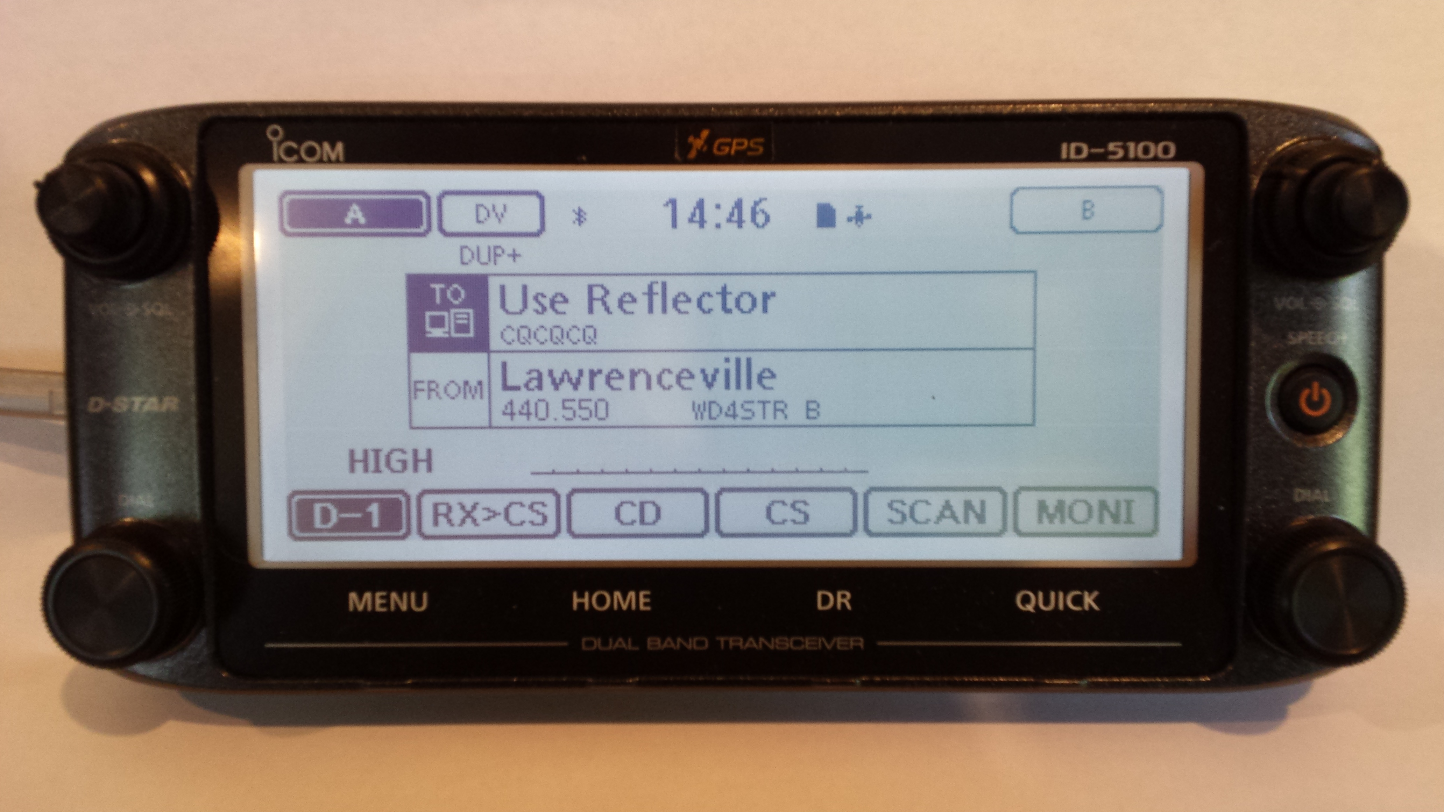
Memory Management –
Method 3 (DR Mode)
Available on ID-31, ID51, IC-7100, ID-5100
Radios have regular memories usually used for FM
Geocoded Repeater List / DR memories used for D-STAR
ID-5100 Repeater List may be used for FM or D-STAR
DR Mode introduces TO/FROM screen for easy use

Slide 19
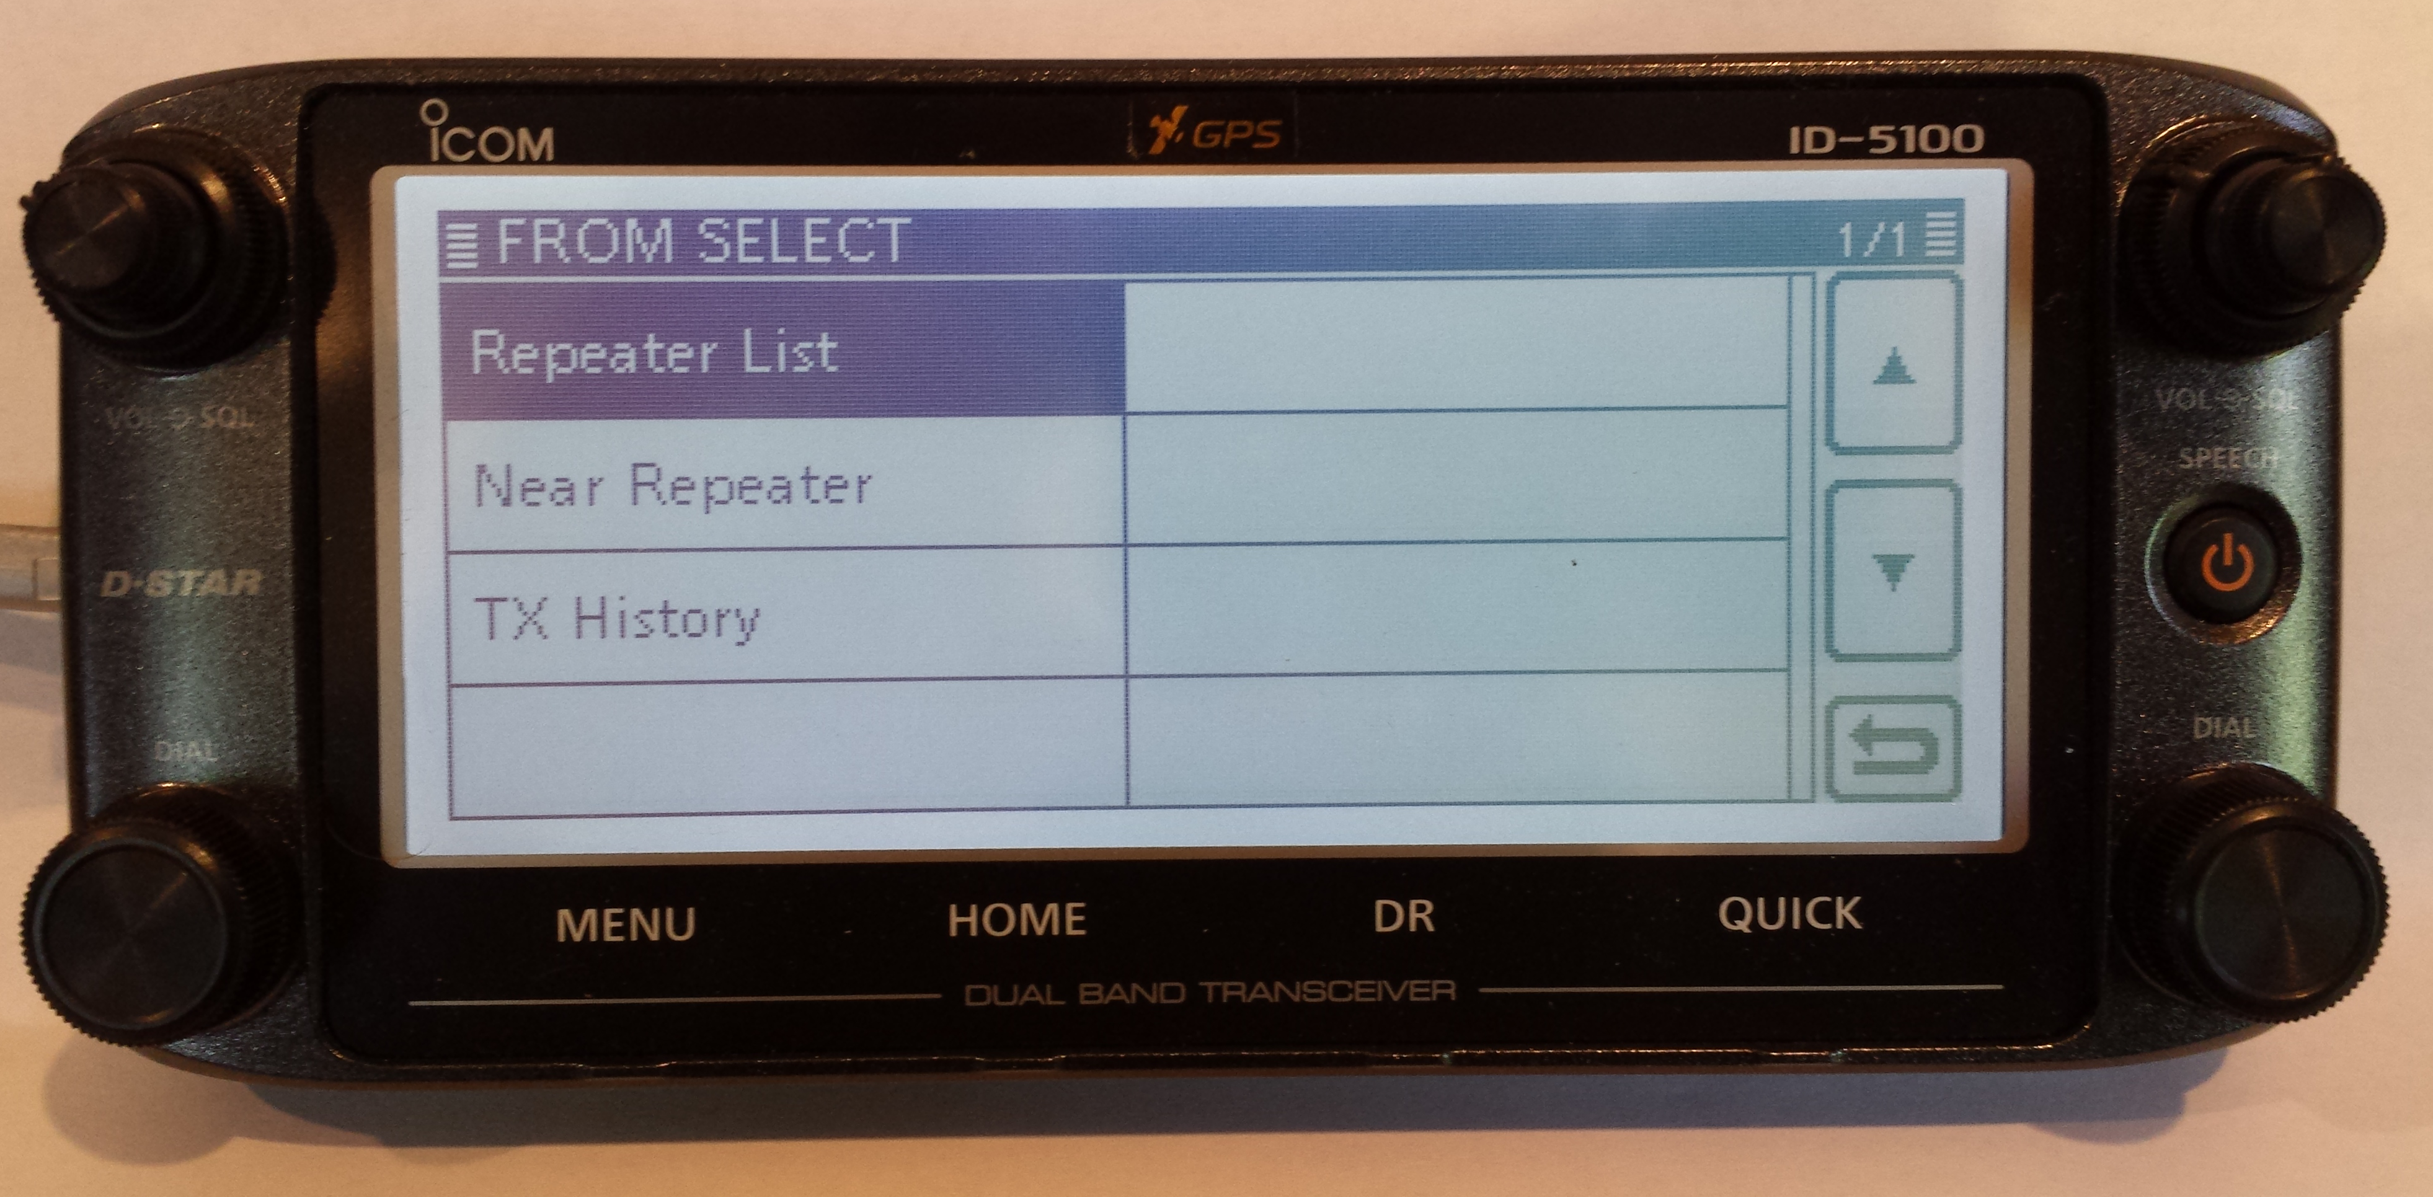
Using DR Mode
Select FROM to pick a repeater
Utilizes internal GPS to know where you are
Repeater List has geocoded repeaters
Selecting Nearest Repeater finds closest repeaters
Select desired repeater

Slide 20
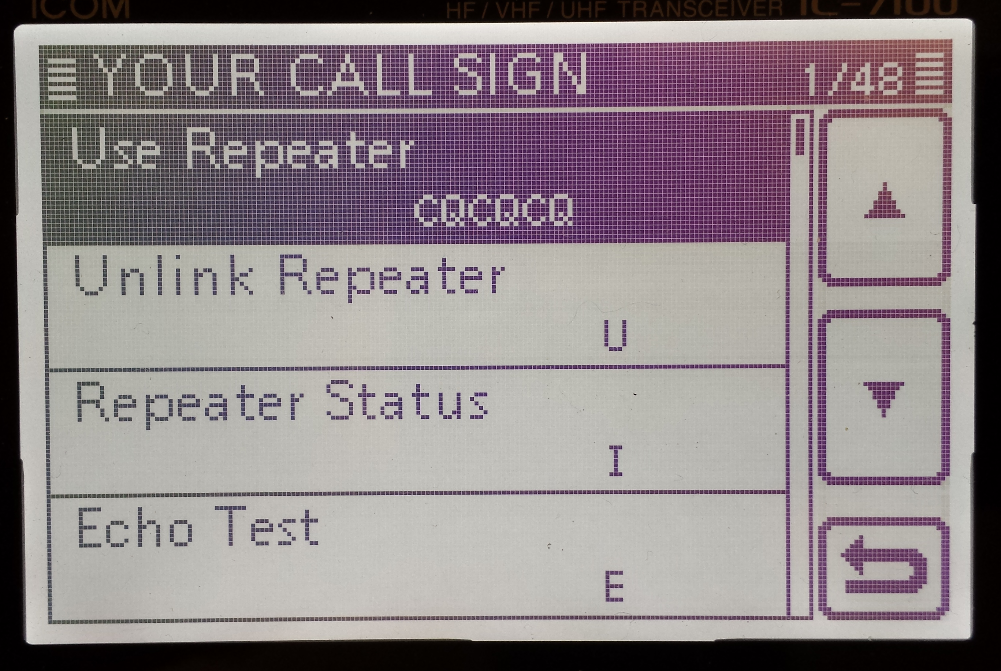
Using DR Mode
Select TO on screen
Select “Your Call Sign” (“Reflector” on ID-5100)
Select “Use Repeater” (“Link to Reflector” on ID-5100) to talk (like CQCQCQ)

Slide 21
DR Mode
Link to a repeater or reflector while in TO field by rotating knob (ID-5100 select Gateway CQ for repeater list or Repeater List>Link to Reflector for list of reflectors)
Return to Use Repeater/Reflector for CQCQCQ for talking

Slide 22
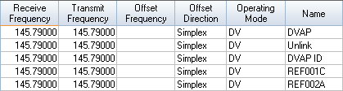
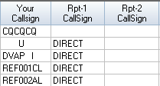
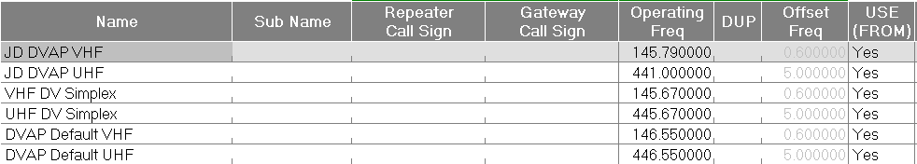
Programming for the DVAP
Standard Memories
Repeater List

Slide 23
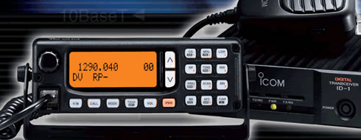
D-STAR’s 1.2 GHz Radio
Icom ID-1
Operates FM Voice or GMSK (D-STAR) modes
D-STAR modes include voice, low speed data (1200 bps) or high speed data (128 kbps)
10W transmit output

Slide 24
ID-1 High Speed Data
Mode
Radio acts as Ethernet wireless bridge
Has RJ-45 Ethernet connector for HS data
Can be used for Internet connectivity through D-STAR repeater with DD module
Can be used to create wireless bridge between two points
When communicating through DD repeater, know assigned IP address (10.x.x.x)

Slide 25
High Speed Data –
DD Mode
Ethernet connection to PC
PC must use assigned IP address assigned at registration (10.x.x.x)
Gateway is 10.0.0.1
Use known DNS addresses
…or the easy way is to insert a router between ID-1 and PC and use DHCP!

Slide 26
Setup With Router
ID-1
Radio
Router
PC
WAN
IP: 10.x.x.x / 255.0.0.0
Gateway: 10.0.0.1
DNS: Use any DNS
PC
Wired or Wi-Fi
DHCP Enabled
Radio Programming
UR: WD4STR
RPT1: WD4STR A
RPT2: WD4STR G
Mode: RPS
LAN
DHCP Enabled
192.168.0.x

Slide 27
What Do You Do?
Take picture
Insert GPS data into meta data
Upload photo to Picasa on Internet using ID-1
View picture on Picasa website
D-RATS chat session can be used for communications with ground

Slide 28
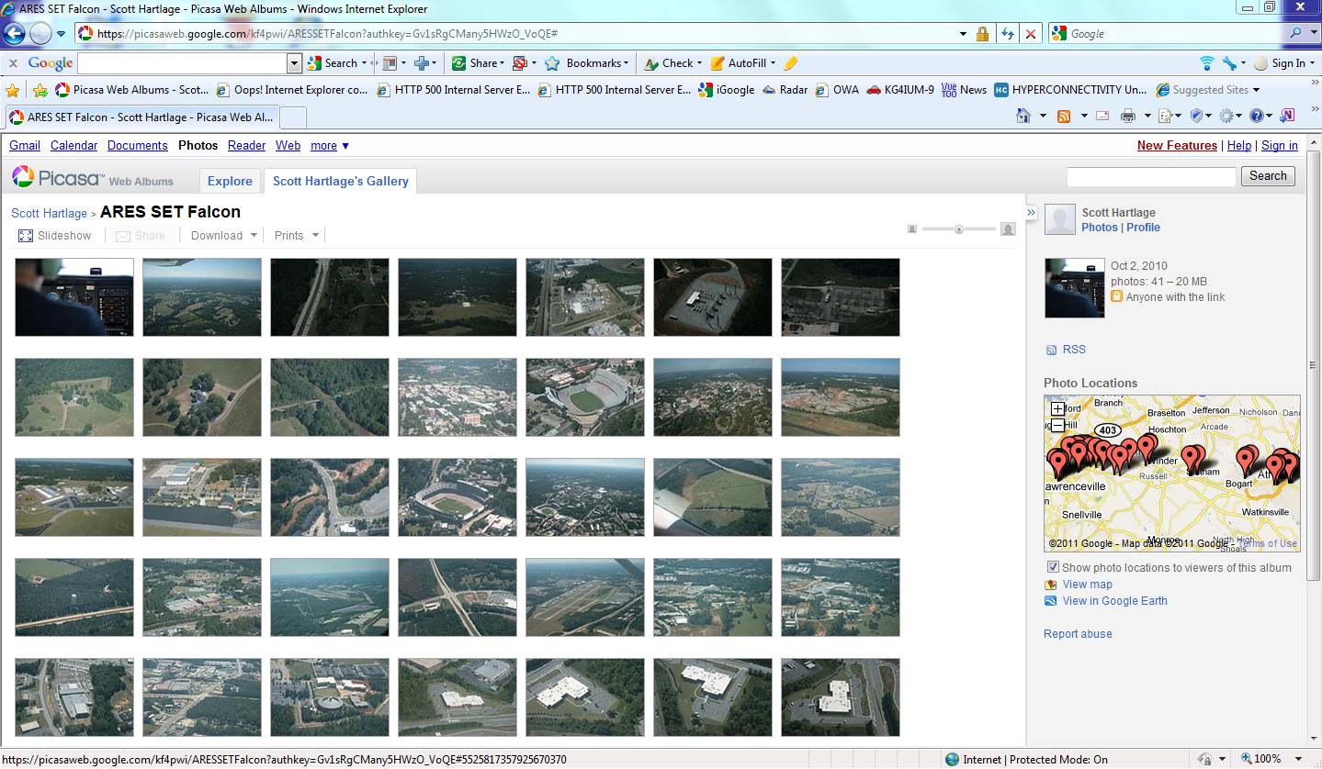
Picasa Website of Pictures

Slide 29
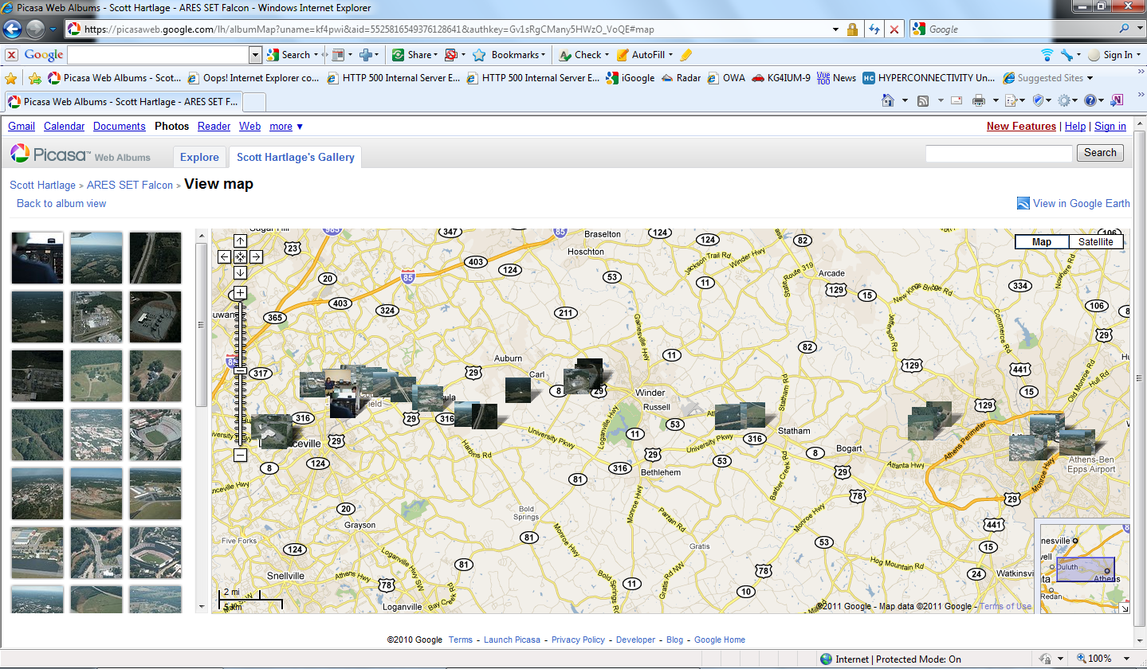
Pictures Display on
Google Maps

Slide 30
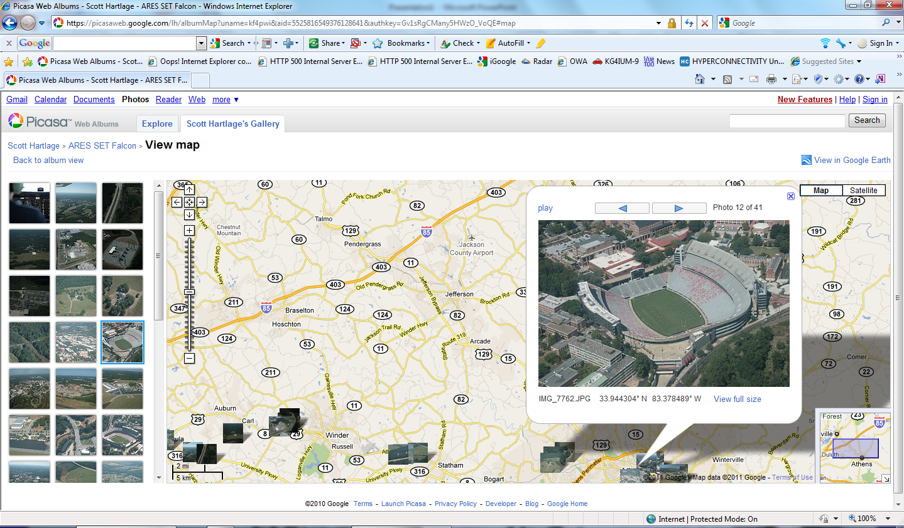
Click on picture to see on map

